Slide 1



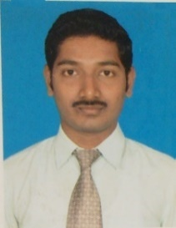
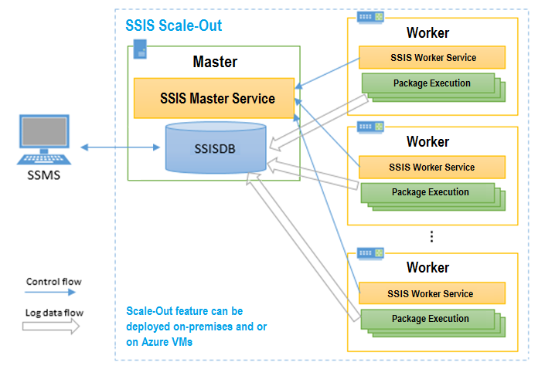
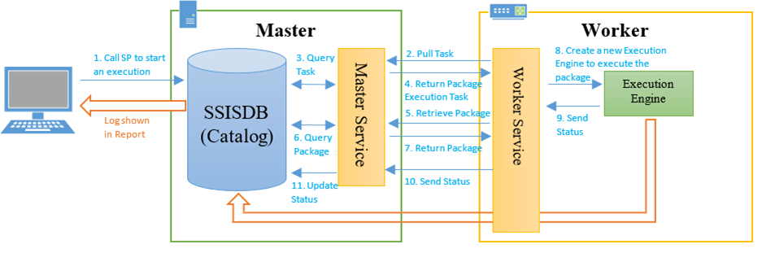
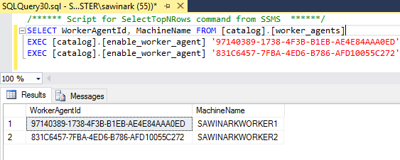
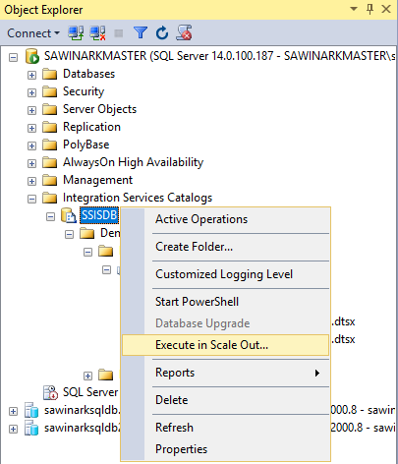
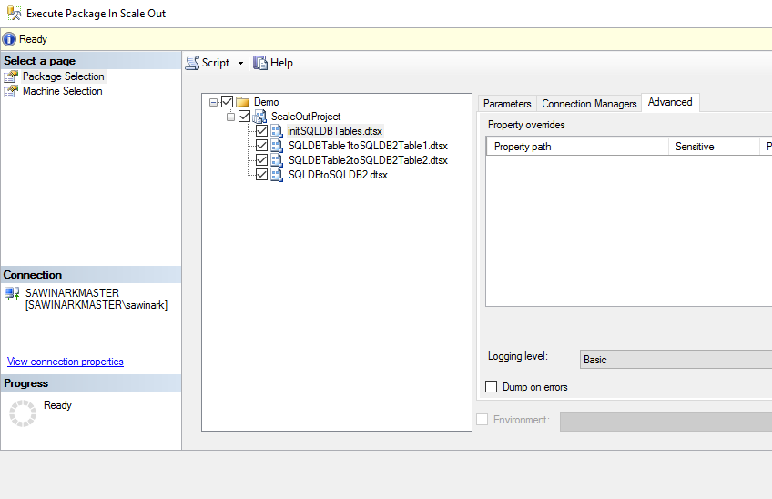
Master Data Management
Microsoft BI-focal lens
SQL Server vNext – Scale out feature
Purpose : Reduce ETL execution time using a scale-out solution on premises and in the cloud that can be managed / monitored with familiar tools
Nagaraj Sengodan, MS Technology Expert with experience in Data Analytics & Business Intelligence based solutions as well traditional data-warehouse implementations using relational databases and ETL tools guiding various customers across Industry.
The overall execution time of ETL workflows per customer across the industry keeps increasing due to:
Increasing number of packages
Increasing data volume from various sources
Increasing complexity in transformation tasks
.
Sample Picture/Screenshot
Scale-Out Master hosts SSISDB and Master Service
Scale-Out Worker hosts Worker Service and SSIS engine
Master Service manages Scale-Out operation by distributing packages to Worker Service
Worker Service initiates SSIS engine to execute packages locally in parallel
These Windows services communicate securely over SSL
Scale-Out Master Installation
Specify the port (8391 by default) and SSL server certificate for Master – Worker communications
Create a default, self-signed server certificate or select an existing server certificate
Scale-Out Worker Installation
SQL Server DB Engine needs not be installed and select just ”Scale Out Worker”
Select Windows account to start Worker Service and its start-up method
By default, a new account is created to start Worker Service automatically
Run packages with Execute Package In Scale Out dialog
### Open the Execute Package In Scale Out dialog box ### In SQL Server Management Studio, connect to the Integration Services server. In Object Explorer, expand the tree to display the nodes under Integration Services Catalogs. Right-click the SSISDB node or the project or the package you want to run, and then click Execute in Scale Out.
This content has been created by BAS – Microsoft Practice – powered by Microsoft Special Interest Group.
For any queries or nominations please write to bas.microsoft@hcl.com or elayaraja.e@hcl.com or sudripta.rakshit@hcl.com

